Slide 1
Amazon Virtual Private Cloud (VPC)
SYS-360

Slide 2
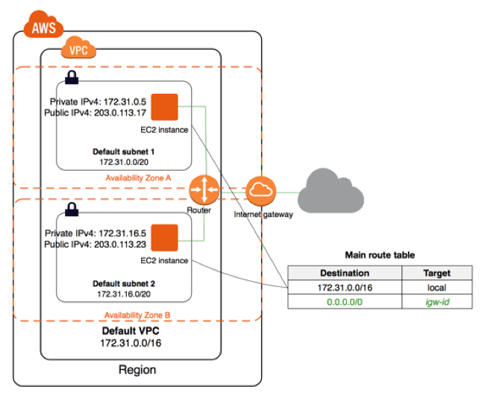
Amazon VPC
Amazon Virtual Private Cloud (Amazon VPC) enables you to launch AWS resources into a virtual network that you've defined.
Amazon VPC is the networking layer for Amazon EC2
The VPC closely resembles a traditional network, with the benefits of using the scalable infrastructure of AWS.

Slide 3
Key Components of VPC
Virtual private cloud (VPC) — A virtual network dedicated to your AWS account.
Subnet — A range of IP addresses in your VPC.
Route table — A set of rules, called routes, that are used to determine where network traffic is directed.
Internet gateway — A gateway that you attach to your VPC to enable communication between resources in your VPC and the internet. Think NAT!

Slide 4
Default VPC
All AWS accounts (since 2013) come with a default VPC
This is also true for our AWS Educate Accounts
Default VPC Components
VPC with a size /16 IPv4 CIDR block (172.31.0.0/16). This provides up to 65,536 private IPv4 addresses.
Size /20 default subnets in each Availability Zone. This provides up to 4,096 addresses per subnet
Create an internet gateway and connect it to your default VPC.
Create a default security group and associate it with your default VPC.

Slide 5
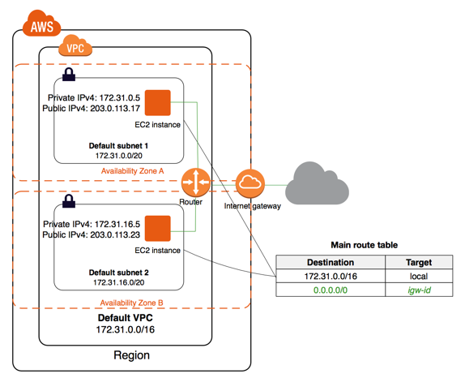
Default VPC
VPC: 172.31.0.0/16
Subnets:
172.31.0.0/20
172.31.16.0/20
172.31.32.0/20…
1 for each availability zone in region. E.g
US-East1
US-East2 ...
Internet Gateway
Provides “Static” NAT to Instances
Amazon controls/configures

Slide 6
Default VPC
You can use a default VPC as you would use any other VPC:
Add additional nondefault subnets.
Modify the main route table.
Add additional route tables.
Associate additional security groups.
Update the rules of the default security group.
Add AWS Site-to-Site VPN connections.
Add more IPv4 CIDR blocks.

Slide 7
Creating Additional (Non-Default) VPCs
Amazon’s VPC Console makes it easy to create additional VPCs
There is no charge for VPCs
However, some services such as VPN’s cost $
There is a VPC Wizard that can help with configuration

Slide 8
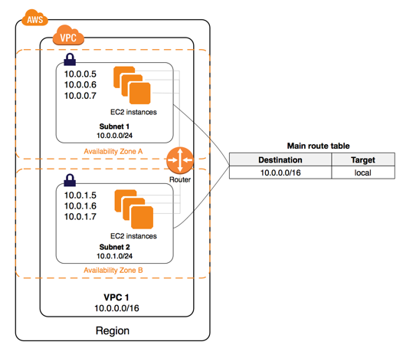
Non-Default VPC
Here is an example of a simple non-default VPC
VPC is 10.0.0.0/16
You can pick any private subnet you want
In this case, 2 subnets were created
Note: There are no Public IP addresses or Internet Gateway
So, no access to Internet

Slide 9
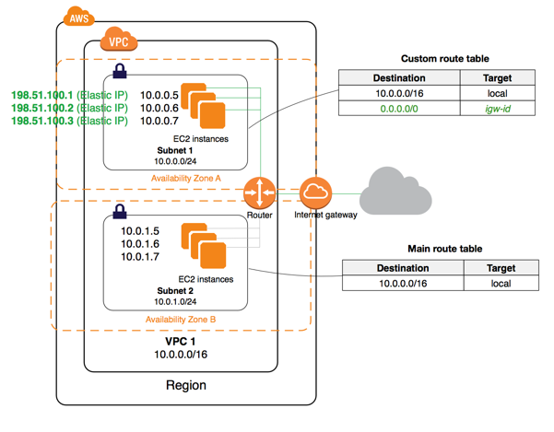
Internet Access for Non-Default VPC
You can enable internet access for an instance launched into a non-default subnet by
attaching an internet gateway to its VPC
and associating an Elastic IP address with the instance.

Slide 10
AWS Internet Gateway
Internet Gateway (IGW) is like a “border router”
Has an interface on your VPC Private Network
Adding a Default Route (0.0.0.0) to the VPC routing table that points to the IGW IP
Allows VPC to send all external traffic to IGW

Slide 11
Elastic IPs
An Elastic IP address is a static, public IPv4 address
You can associate an Elastic IP address with any instance or network interface in any VPC in your account.
With an Elastic IP address, you can mask the failure of an instance by rapidly remapping the address to another instance in your VPC.

Slide 12
Elastic IPs...
To use an Elastic IP address, you first allocate it for use in your account.
Then, you can associate it with an instance or network interface in your VPC.
Your Elastic IP address remains allocated to your AWS account until you explicitly release it.

Slide 13
Elastic IP Rules
An Elastic IP address can be associated with a single instance or network interface at a time.
You can move an Elastic IP address from one instance or network interface to another.
Limited to 5 Elastic IP’s per account
No charge when Elastic IP is associated with a running instance
To ensure efficient use of Elastic IP addresses,there is a small hourly charge when they are reserved but not associated with a running instance

Slide 14
VPC Definitions
A subnet is a segment of the VPC IP address range, where we can launch EC2 Instances, RDS, and other AWS resources.
Subnets are further classified as Public and Private.
Public subnets hold resources that can be accessed from the Internet.
Common attributes for instances in Public Subnets to have are:
Elastic IP (EIP) address or Public IP address attached to the EC2 instance.
IGW attached to the VPC.
The subnet must have a route table entry with destination as internet gateway (IGW) 0.0.0.0/0.
Private Subnets not accessible from Internet (unless using NAT)

Slide 15
VPC Definitions - Route Tables
Multiple subnets can be associated with a single route table. However, a single subnet cannot be associated with multiple route tables.
Route tables hold sets of rules, called routes that are used to determine where the traffic is directed.
Every subnet in a VPC is linked to the route table.
Primary or Main route tables are the ones that automatically come with your VPC. They control the routing for all subnets that are not explicitly associated with any other route table.
The default route table cannot be deleted.
Custom route tables are the ones you create for your VPC, and you can add routes as needed.
Custom route tables can be deleted when not required.

Slide 16
VPC Definitions - Internet Gateways
Internet Gateway (IGW) is a virtual router which helps a VPC connect to the Internet.
By default, instances that are launched in a VPC cannot communicate with the Internet. To enable Internet access, Internet gateway needed to be attached to the VPC.
Public subnets gets connected to IGW through route tables to get accessed over the Internet.
Internet Gateways are horizontally scalable, highly available and redundant.

Slide 17
VPC Definitions - NAT and ACLs
NAT devices can be either an Instance / Gateway residing in Public subnet, (to which an EIP is assigned).
NAT devices help instances in Private subnets interact with the Internet.
Access Control List (ACL) is an optional layer of security that acts as a firewall for controlling network traffic in and out of the subnet.
Rules are defined with the ACL for allowing or denying network traffic either on ports / IP addresses.

Slide 18
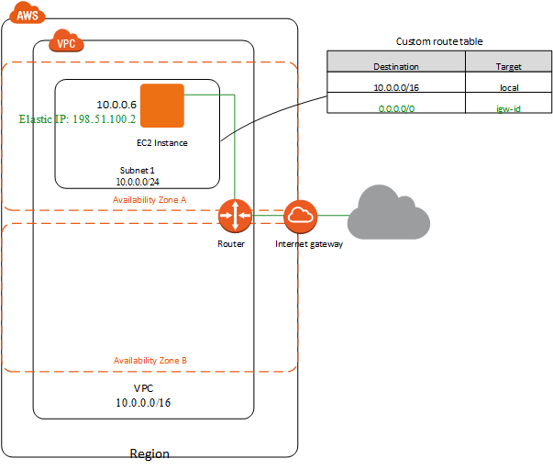
VPC With Single Public Subnet

Slide 19
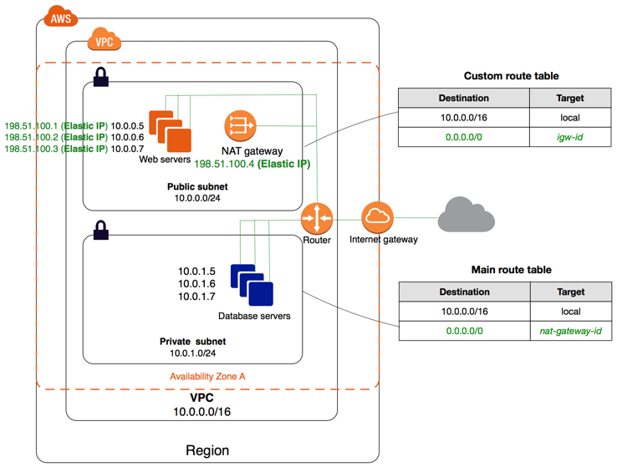
VPC with Public and Private Subnets

Slide 20
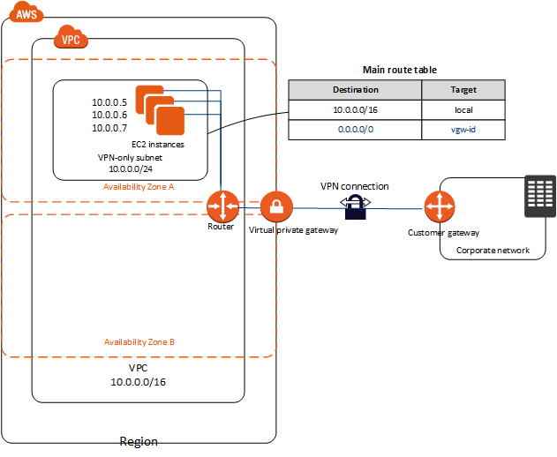
VPC with Private Subnet and Site-to-Site VPN
Very Common
Can extend private data center to cloud!

Slide 21
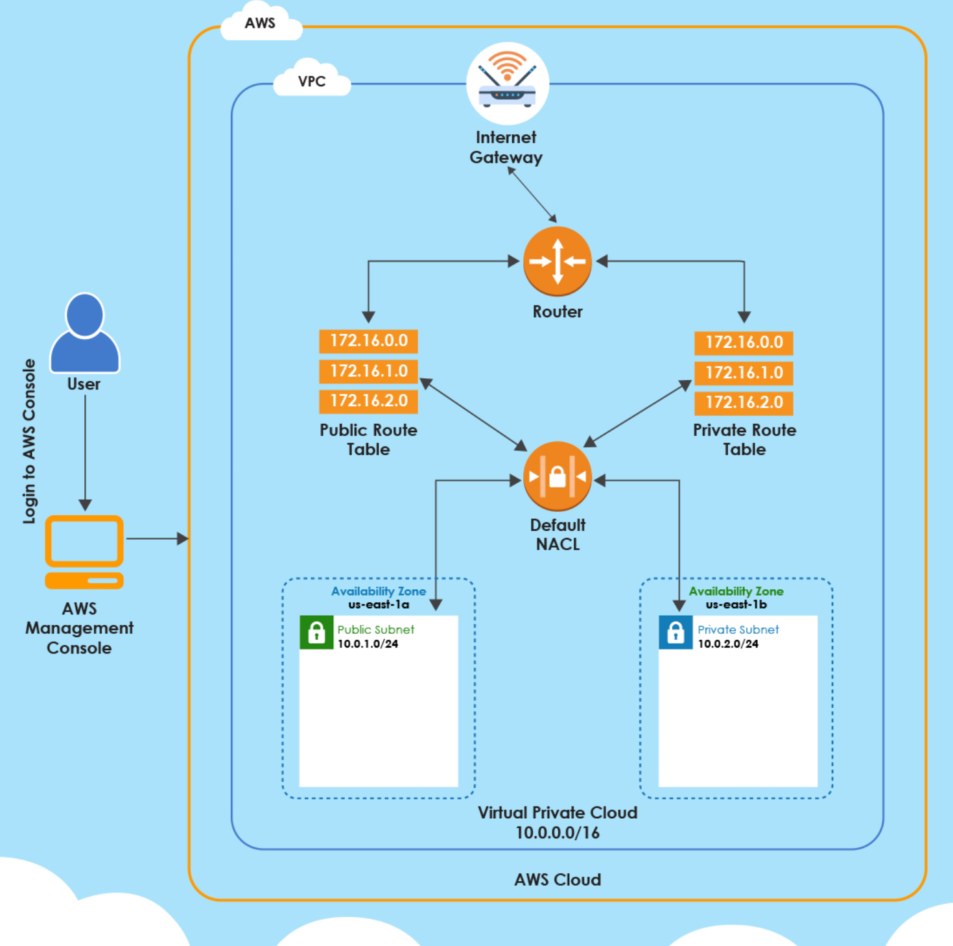
Lab

